Slide 1
WorkShop
Documenting Code
Instituto Politécnico do Cávado do Ave
Escola Superior de Tecnologia
Ano letivo de 2020-2021

Slide 2
Documenting code
Visual Studio: C# code templates
Methods:
  Snippets
    https://docs.microsoft.com/en-us/visualstudio/ide/walkthrough-creating-a-code-snippet?view=vs-2019
  Programming
    Find all files and change contents
  Templates

Slide 3
Documenting code
Visual Studio Templates
Project Templates
.vstemplate files - project files to be created
  https://docs.microsoft.com/en-us/visualstudio/ide/how-to-create-project-templates?view=vs-2019
Item Templates
- templates for customizing source code files (classes, interfaces, etc.)

Slide 4
Documenting code
Visual Studio Templates
Item Templates
Updating existing Templates
Create new Templates
  https://docs.microsoft.com/en-us/visualstudio/ide/creating-project-and-item-templates?view=vs-2019

Slide 5
Documenting code
Visual Studio Templates
Updating existing “Item Templates”
Installed Templates Path:
  %ProgramFiles(x86)%\Microsoft Visual Studio\2019\<edition>\Common7\IDE\ProjectTemplates\<Language>\<Locale ID>
  %ProgramFiles(x86)%\Microsoft Visual Studio\2019\<edition>\Common7\IDE\ItemTemplates\<Language>\<Locale ID>
C:\Program Files (x86)\Microsoft Visual Studio\2019\Community\Common7\IDE\ItemTemplates\CSharp\1033
- Local ID English (LCID 1033) -
C:\Program Files (x86)\Microsoft Visual Studio\2019\Community\Common7\IDE\ItemTemplates\CSharp\Code\1033\Class

Slide 6
Documenting code
Visual Studio Templates
Updating existing Installed “Item Templates”
C:\Program Files (x86)\Microsoft Visual Studio\2019\Community\Common7\IDE\ItemTemplates\CSharp\Code\1033\Class
See Class.cs

Slide 7
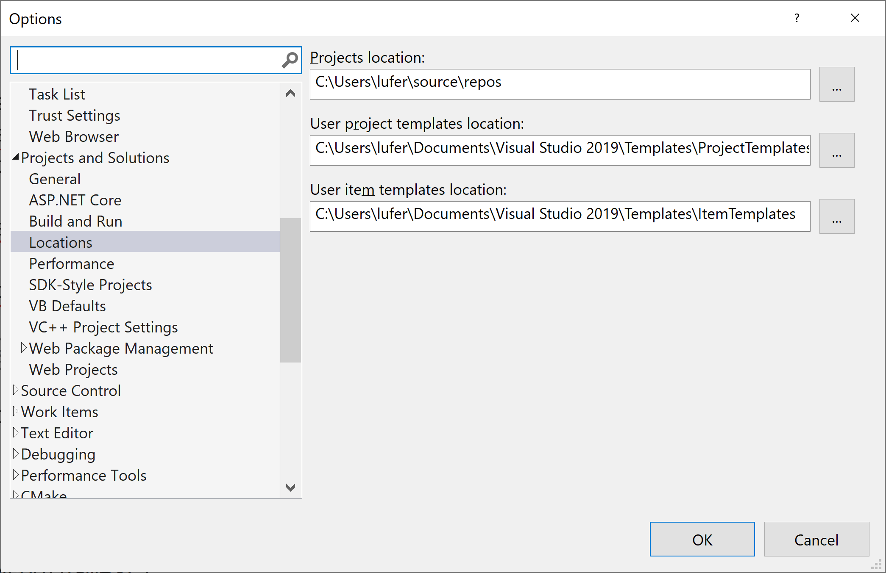
Documenting code
Visual Studio Templates
Creating Item Templates
User Templates:
  %USERPROFILE%\Documents\Visual Studio 2019\Templates\ProjectTemplates
  %USERPROFILE%\Documents\Visual Studio 2019\Templates\ItemTemplates
C:\Users\lufer\Documents\Visual Studio 2019\Templates\ItemTemplates\Visual C#

Slide 8
Documenting code
Visual Studio Templates
Creating Item Templates
Template Parameters
  $parameterName$
  https://docs.microsoft.com/en-us/visualstudio/ide/template-parameters?view=vs-2019
Steps:
  Create new Library project
  Define parameters in class
  Export template
  Put template in User Path

Slide 9
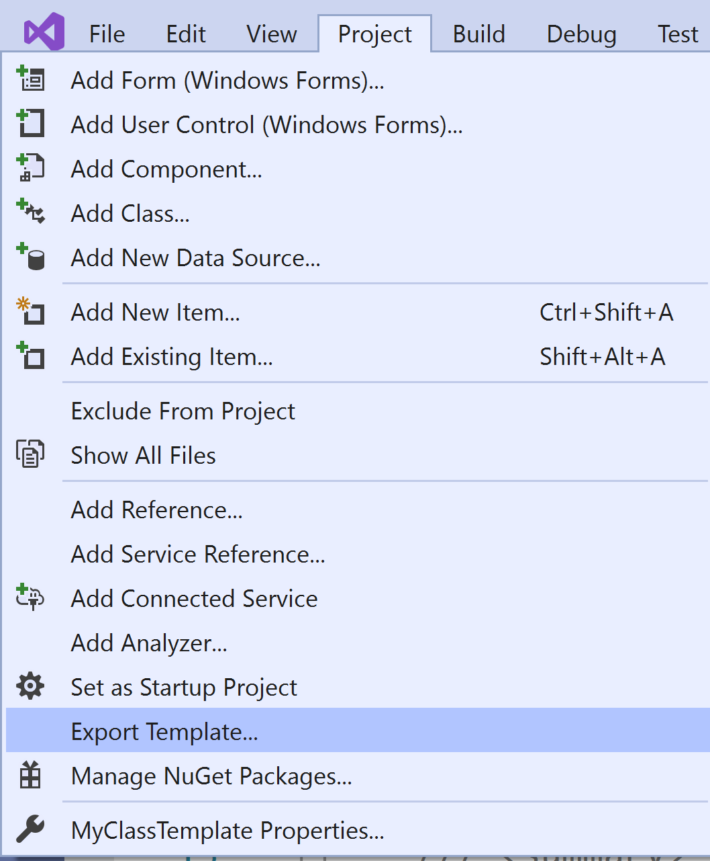
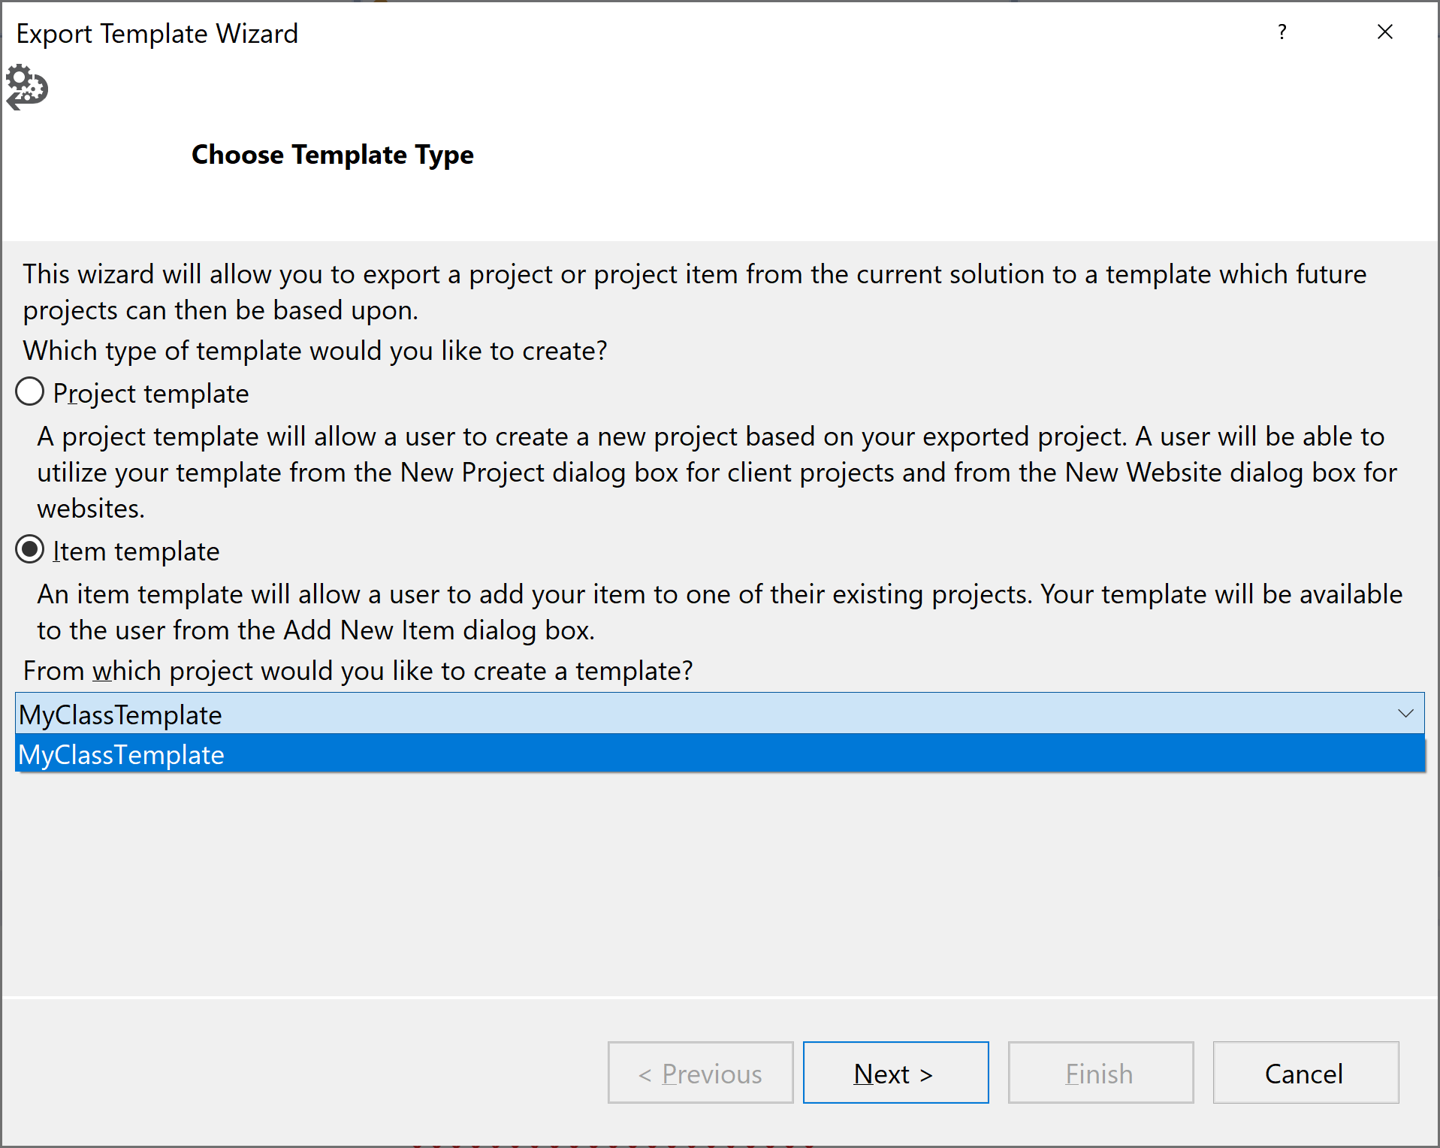
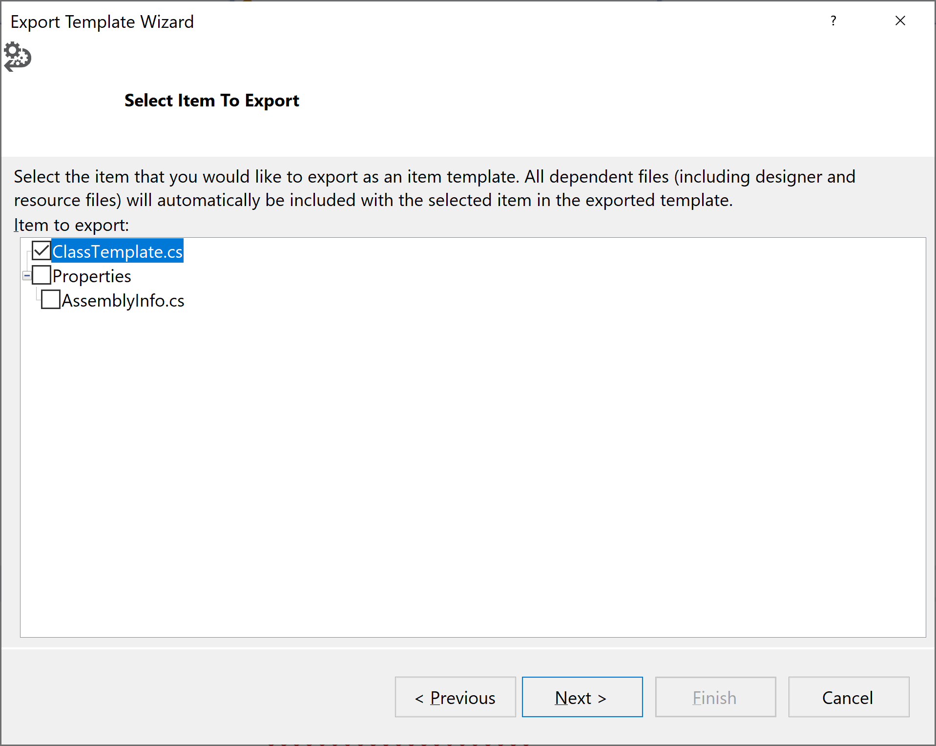
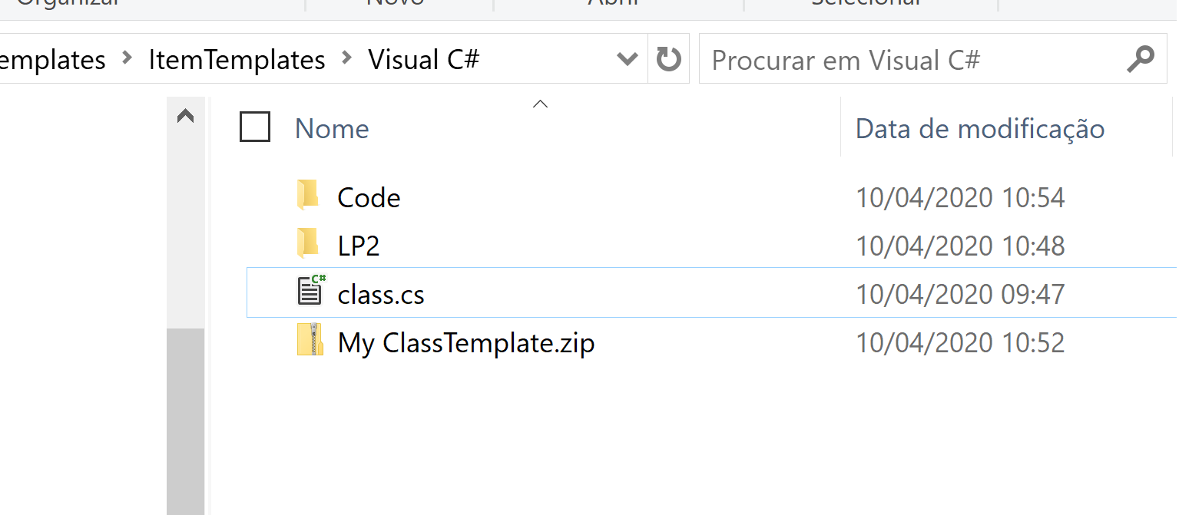
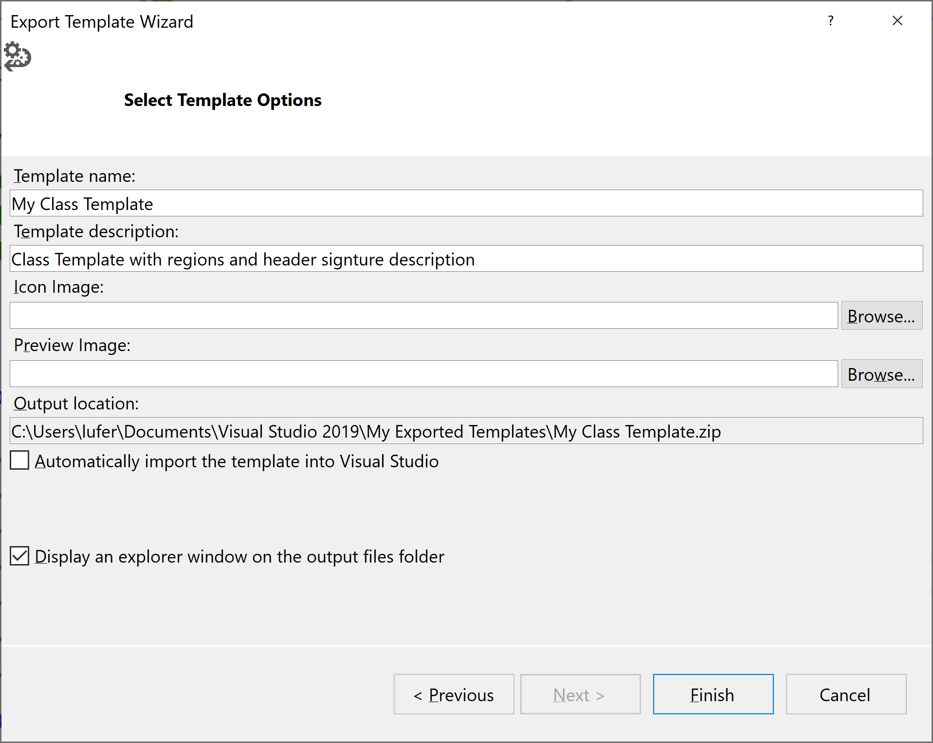
Documenting code
Visual Studio Templates
Creating Item Templates
It creates a “.zip” in C:\Users\USER\Documents\Visual Studio 2019\My Exported Templates\
Copy “.zip” to C:\Users\lufer\Documents\Visual Studio 2019\Templates\ItemTemplates\Visual C#

Slide 10
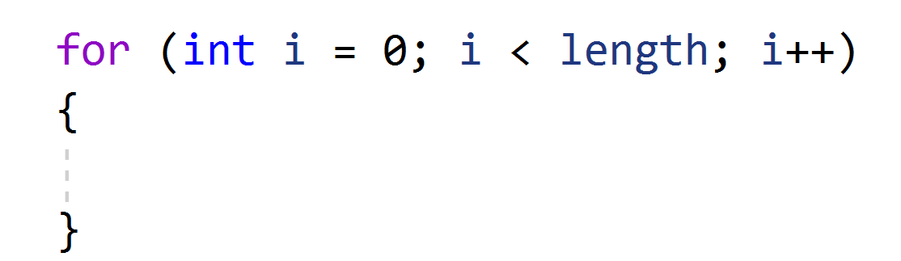
Documenting code
Visual Studio snippets
  Ctrl + K + X
  https://docs.microsoft.com/en-us/visualstudio/ide/walkthrough-creating-a-code-snippet?view=vs-2019
  Snippet + Tab + Tab
  Example: “for” + tab + tab

Slide 11
Documenting code
Generate API documentation
External documentation of my source code
Tools:
Doxygen
SandCastle
GhostDoc
Others

Slide 12
Documenting code
Documenting C code for Doxygen (ex. Visual Source Code)
/**
* @file teste.c
* @author your name (you@domain.com)
* @brief
* @version 0.1
* @date 2020-10-16
*
* @copyright Copyright (c) 2020
*
*/
/**
* @brief
*
*
* @param x
* @param y
* @return int
*/
int soma(int x, int y){
return x+y;
}
Signature header file
Function documentation

Slide 13
Documenting code
Documenting C code (ex. Visual Source Code)
/**
* @file teste.c
* @author your name (you@domain.com)
* @brief
* @version 0.1
* @date 2020-10-16
*
* @copyright Copyright (c) 2020
*
*/
/**
* @brief
*
*
* @param x
* @param y
* @return int
*/
int soma(int x, int y){
return x+y;
}
Install Extension “Doxygen Documentation Generator”
Signature header file
Function documentation

Slide 14
Documenting code
Documenting C code for Doxygen (ex. Visual Studio)
//**
* \file Hoje.c
* \brief
*
* \author lufer
* \date October 2020
*************************/
#include <stdio.h>
/**
* .
*
* \param x
* \param y
* \return
*/
int soma(int x, int y) {
return x + y;
}
Signature header file
Function documentation

Slide 15
Documenting code
Documenting C code for Doxygen (ex. Visual Studio)
//**
* \file Hoje.c
* \brief
*
* \author lufer
* \date October 2020
*************************/
#include <stdio.h>
Install Extension “Doxygen Comments”
/**
* .
*
* \param x
* \param y
* \return
*/
int soma(int x, int y) {
return x + y;
}
Signature header file
Function documentation

Slide 16
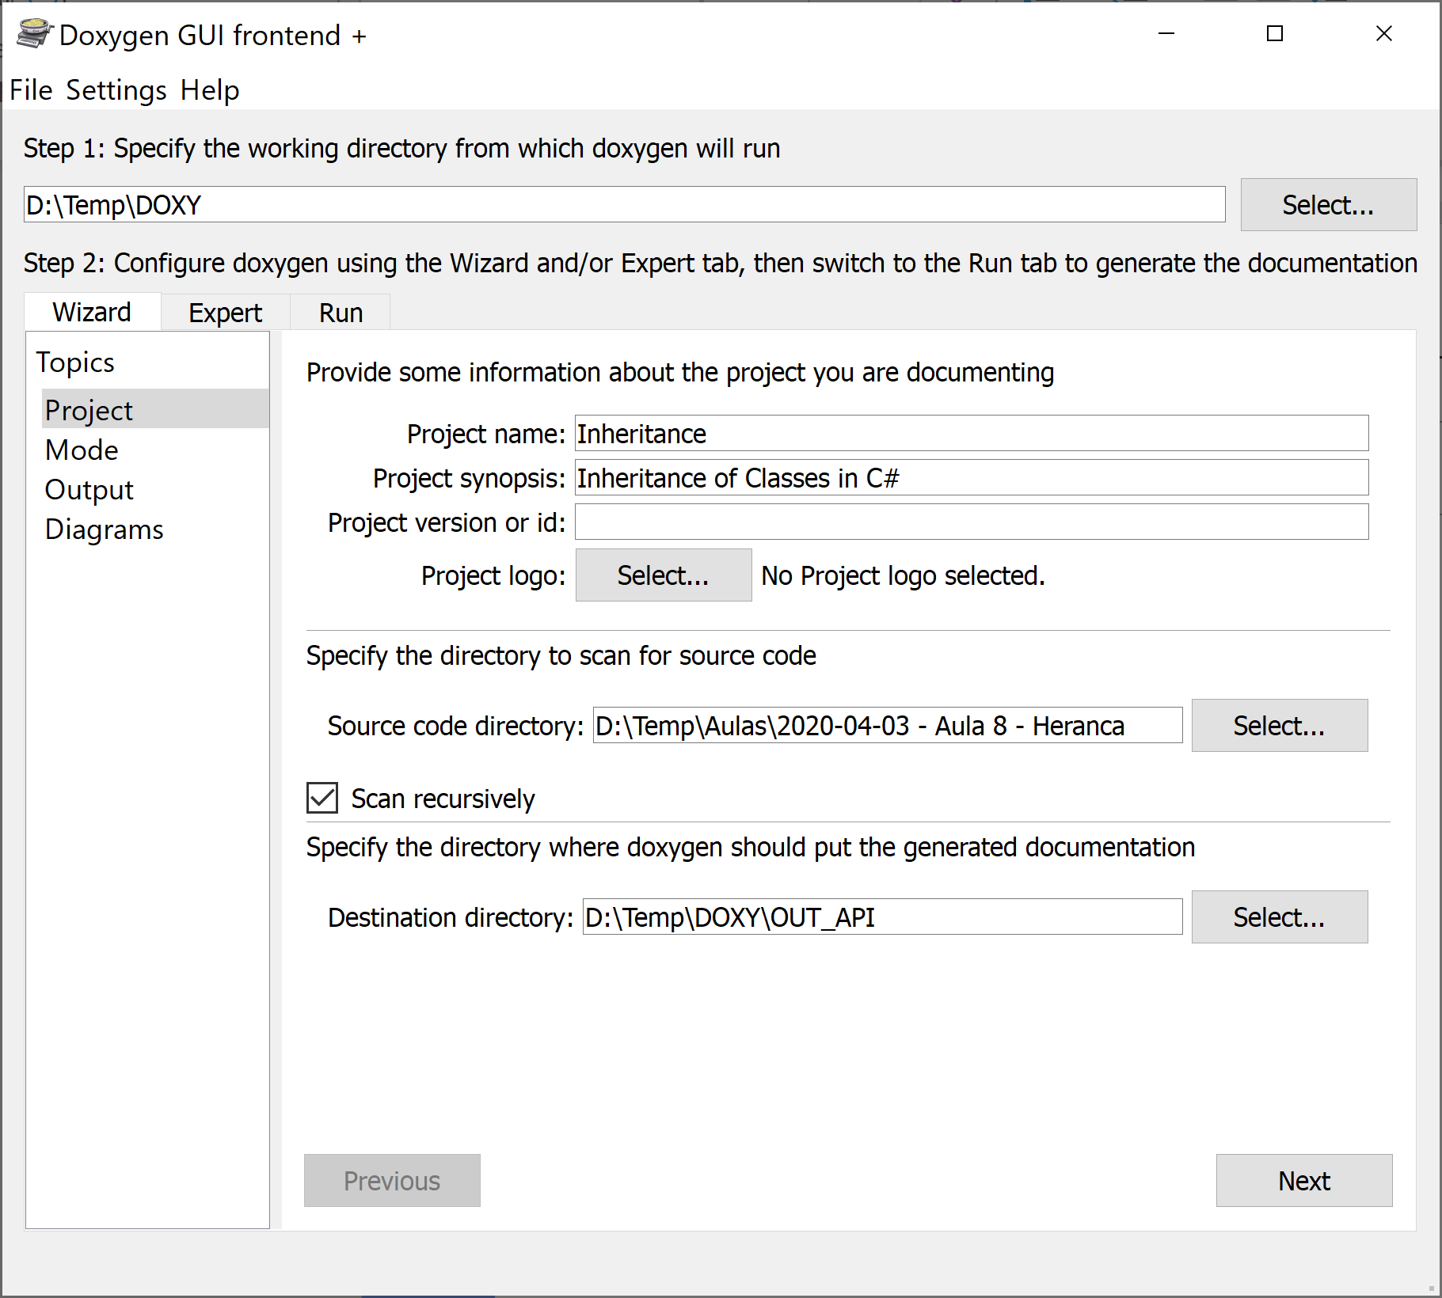
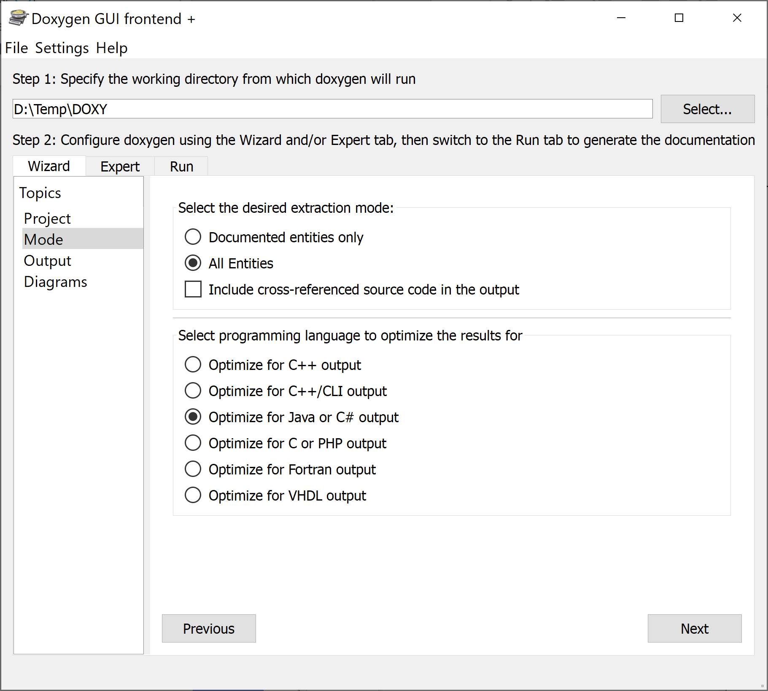
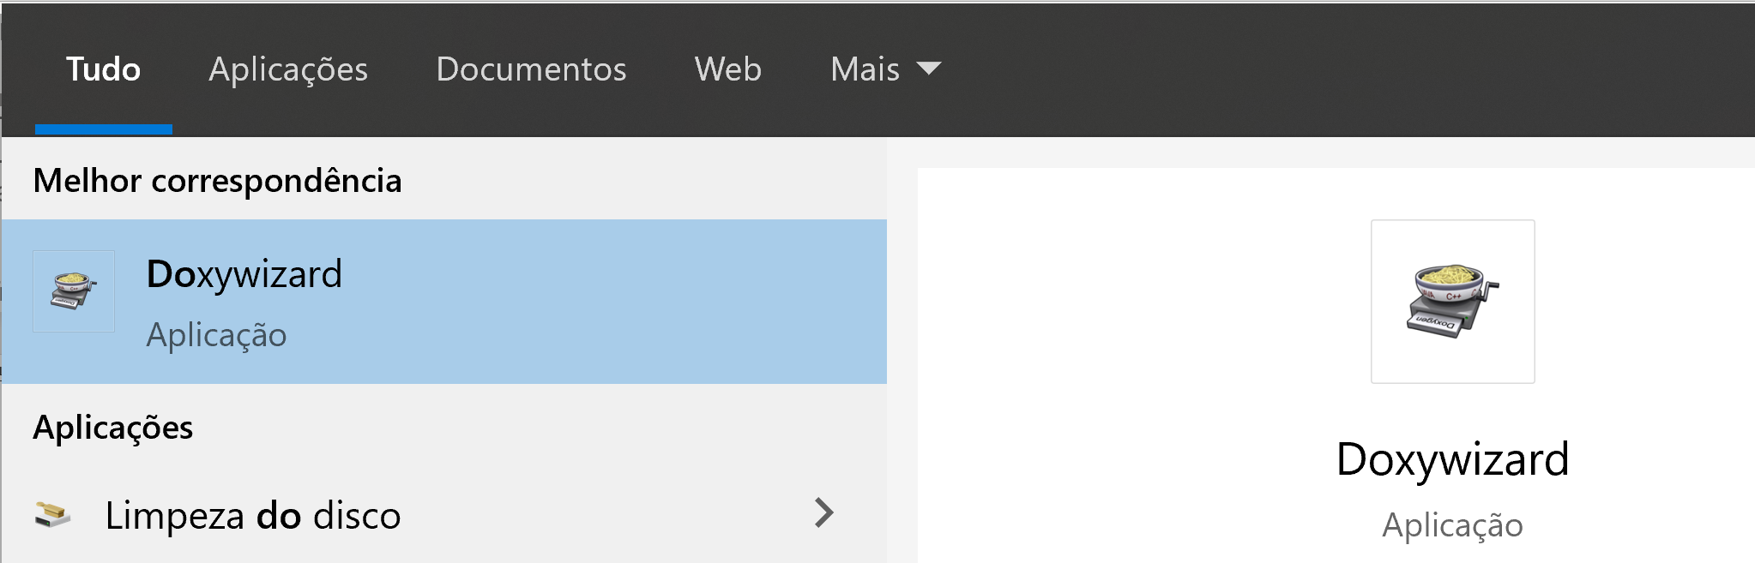
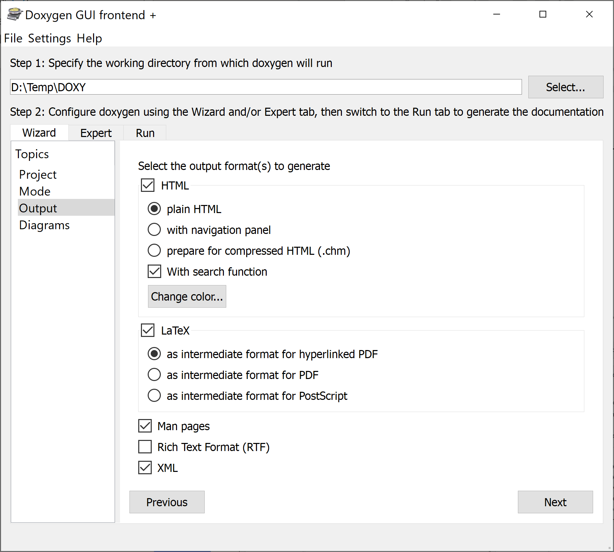
Documenting code
Generate API documentation: Doxygen
Documenting C Code
Documenting C# Code

Slide 17
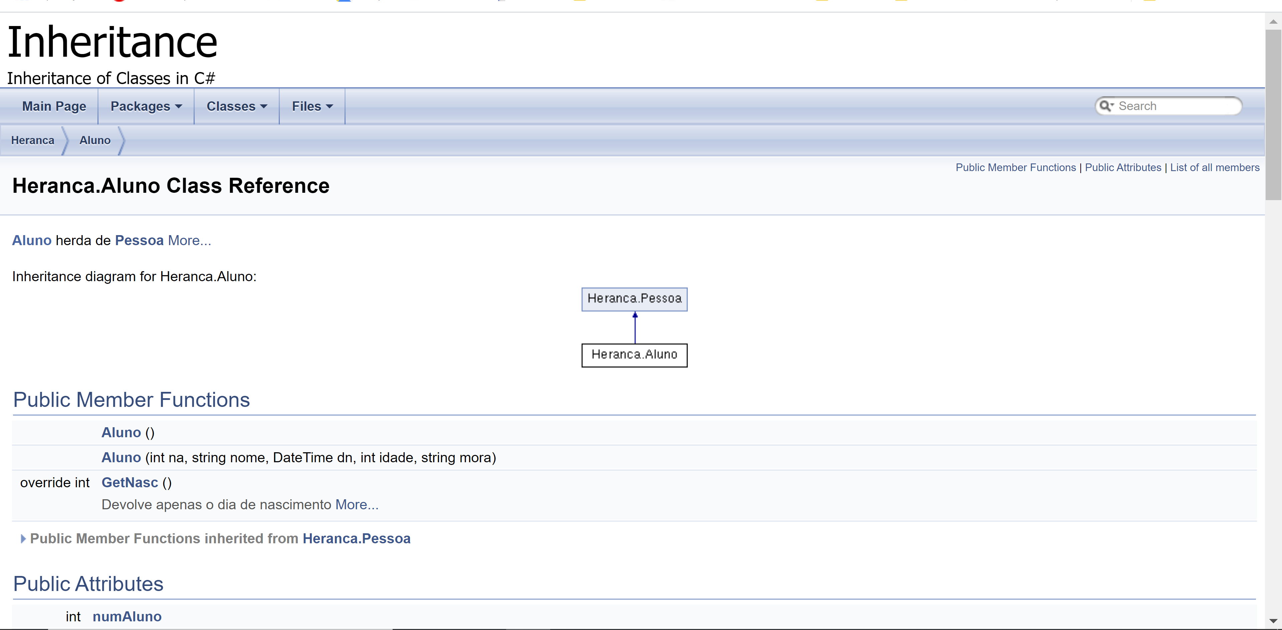
Documenting code
Generate API documentation: Doxygen
External documentation of my source code

Slide 18
Documenting code
Paths
Installed templates
C:\Program Files (x86)\Microsoft Visual Studio\2019\Community\Common7\IDE\ItemTemplates\CSharp\Code\1033\Class
User Templates
C:\Users\USER\Documents\Visual Studio 2019\Templates\ItemTemplates\Visual C#
Snippets:
C:\Program Files (x86)\Microsoft Visual Studio\2019\Community\VC#\Snippets\1033\Visual C#
Extensions
C:\Program Files (x86)\Microsoft Visual Studio\2019\Community\Common7\IDE\Extensions\Microsoft\Dot Net\ItemTemplates\Code\1033\Class

Slide 19
Documenting code
References
https://docs.microsoft.com/en-us/visualstudio/ide/?view=vs-2019
https://docs.microsoft.com/en-us/visualstudio/ide/creating-project-and-item-templates?view=vs-2019
https://docs.microsoft.com/en-us/visualstudio/ide/customizing-project-and-item-templates?view=vs-2019
https://docs.microsoft.com/en-us/dotnet/csharp/tutorials/intro-to-csharp/
https://www.youtube.com/watch?v=3uYN3mDFP-o
https://docs.microsoft.com/en-us/visualstudio/ide/template-parameters?view=vs-2019

Slide 20
Documenting code
References
Documenting C Code with Doxygen
  https://embeddedinventor.com/guide-to-configure-doxygen-to-document-c-source-code-for-beginners/

